Slide 1
Probabilistic Wildfire Spread Modeling Using Markov Decision Processes
Kaushal Sambanna, Devansh Makam
March 3, 2025

Slide 2
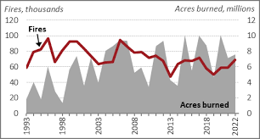
Problem Definition & Significance
Wildfires are increasing in frequency and severity due to climate change.
Causes massive ecological, economic, and human losses.
Effective prediction models are essential for disaster response.
Traditional models struggle with uncertainty in fire spread behavior.

Slide 3
Existing Approaches & Their Mathematical Models
A. Cellular Automata (CA) Models
Fire spread is modeled using a discrete grid system where each cell follows predefined transition rules.
State transition equation:
S_{t+1}(x, y ) = f (S_{t} (x, y ), S_{t} (N(x, y )))
Limitations: Fixed rules, does not adapt well to real-time environmental changes.
B. Physical Fluid Dynamics Models (PDE-based)
Uses differential equations to model fire spread as a heat transfer process.
Governing equation:
∂T
∂t
= ∇ · (k∇T ) + Q
Limitations: Computationally expensive, requires detailed environmental and topographical data.
C. Deep Learning-Based Models
Predicts fire spread using historical data and neural networks.
Temporal prediction using RNNs:
H_{t} = W_{h} H_{t-1} + W_{x} X_{t} + b_{h}
Limitation: Requires large labeled datasets, lacksinterpretability, poor generalization to new environments.

Slide 4
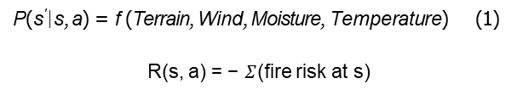
Our Model: Markov Decision Process (MDP) Approach
Why MDP?
Fire spread is stochastic → MDP models uncertainty.
Dynamically updates fire transitions based on probabilistic learning.
Mathematical Formulation:
P(s′|s, a) = f (Terrain, Wind, Moisture, Temperature) (1)
R(s, a) = − $Σ$(fire risk at s)
(2)

Slide 5
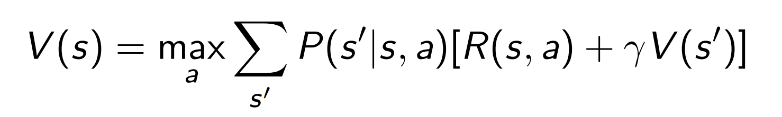
Mathematical Model Implementation
Fire Spread Probability Calculation:
^{P}spread ^{= P}terrain ^{× P}wind ^{× P}moisture ^{× P}temperature
(3)
Bellman Equation for Fire Propagation:
(4)

Slide 6
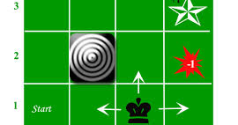
MDP illustration

Slide 7
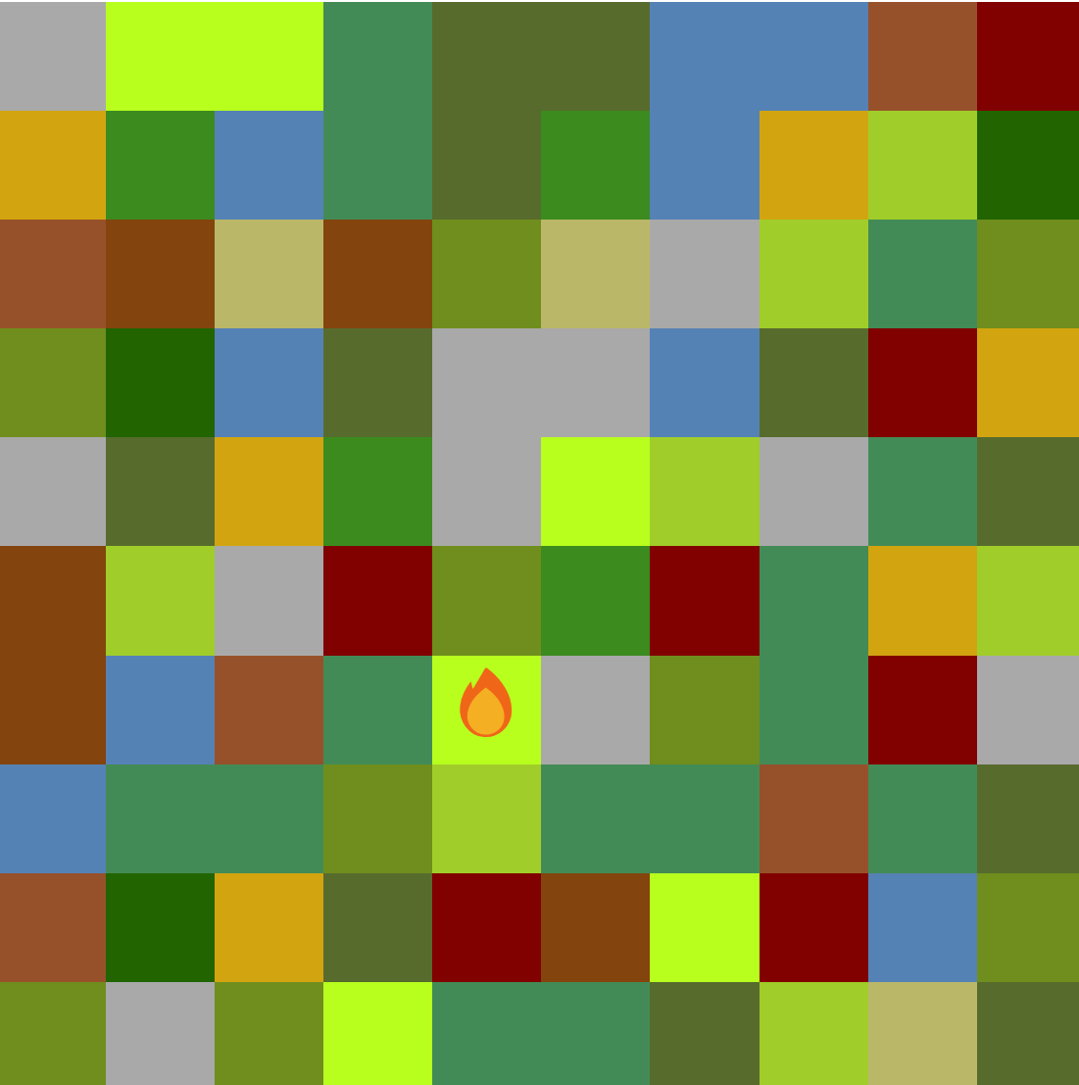
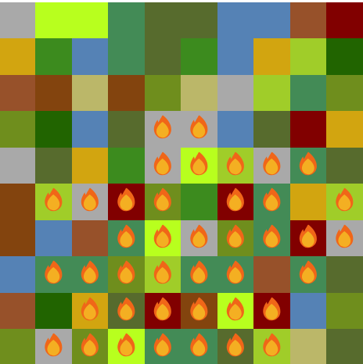
Example Simulation Results
Fire Spread Simulation Grid (before and after predictions).
Comparison with real wildfire cases → Validates accuracy.

Slide 8
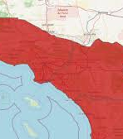
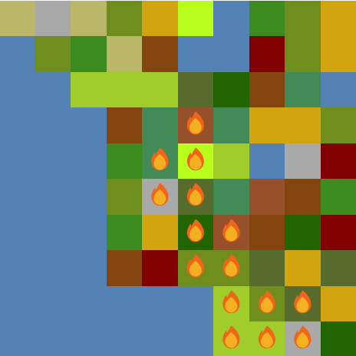
Validation
California wildfire
MDP Simulation

Slide 9
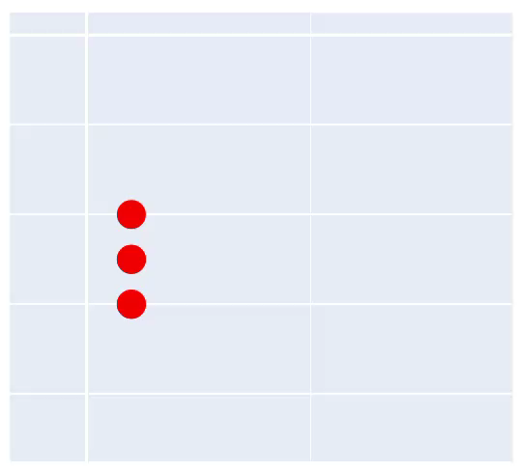
Why Our Model is Better?
Handles uncertainty better than rule-based models.
Computationally efficient compared to PDE-based simulations.
Scalable to different terrains and environmental factors.
Provides interpretable probabilistic decision-making for fire response.

Slide 10
Future Outlook & Applications
Train on real-time satellite data for better predictions.
Integrate with AI for adaptive fire mitigation.
Emergency planning, real-time wildfire tracking.
Climate impact analysis on wildfire risks.

Slide 11
References
https://www.everycrsreport.com/reports/IF10244.html
https://www.nifc.gov/fire-information/statistics/wildfires
https://open.alberta.ca/dataset/a221e7a0-4f46-4be7-9c5a-e29de9a3447e/resource/1b635b8b-a937-4be4-857e-8aeef77365d2/download/fp-historical-wildfire-data-dictionary-2006-2024.pdf
https://www.earthdata.nasa.gov/data/tools/firms
https://www.sciencedirect.com/topics/computer-science/markov-decision-process

